Slide 1
Antony ching web project – Simple date

Slide 2
Introduction
This demo is currently under development.
The web pages are written in PHP.
This web application is a dating website. It allows users to create personal profiles, invite others for dates and message each other privately.
The USP of this website is that users are expected to accept dates invites from anonymous users and get to know each other through the messaging system.

Slide 3
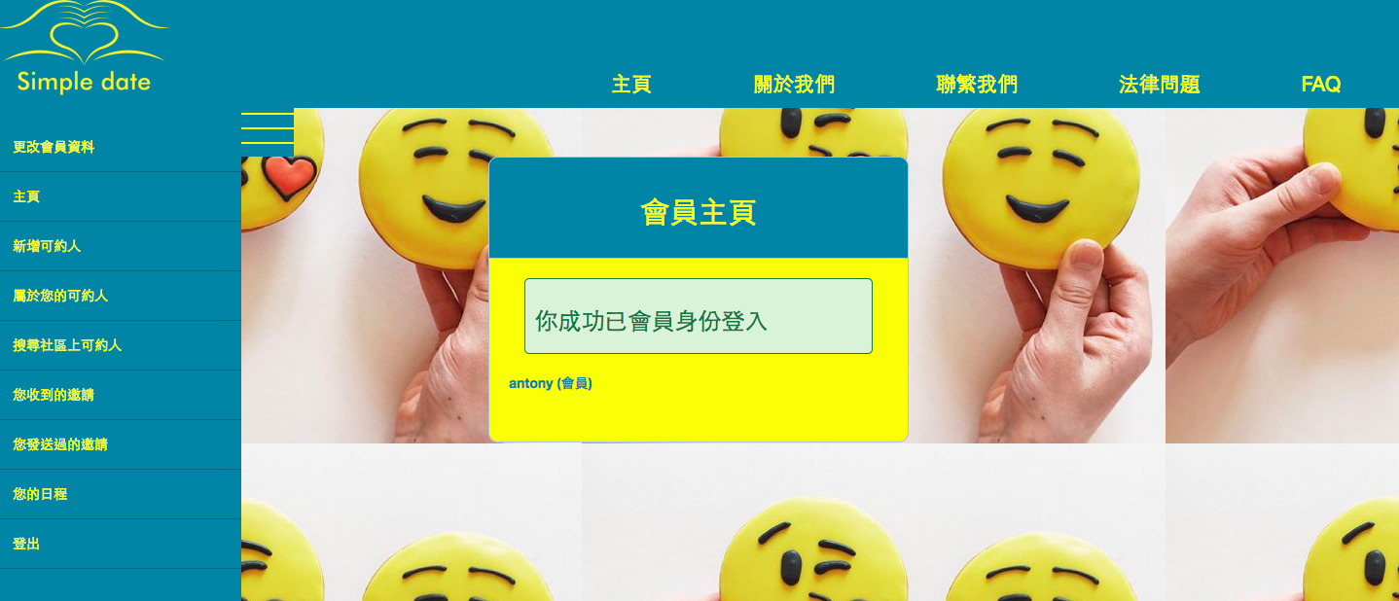
主頁
This is the homepage of the application – home.php and it consists a sidebar menu that is also embedded in all the other pages.
The sidebar menu can be toggled and it consists other functions.

Slide 4
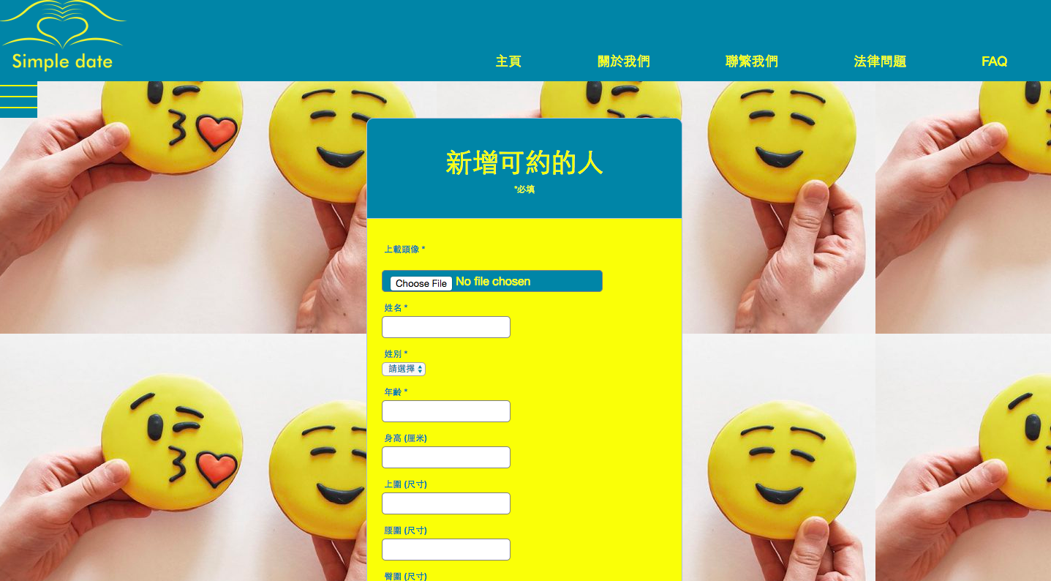
新增可約人
This is the homepage for one of the main component Object Repository
Each user can create more than one profile and they can be created within addClient.php.

Slide 5
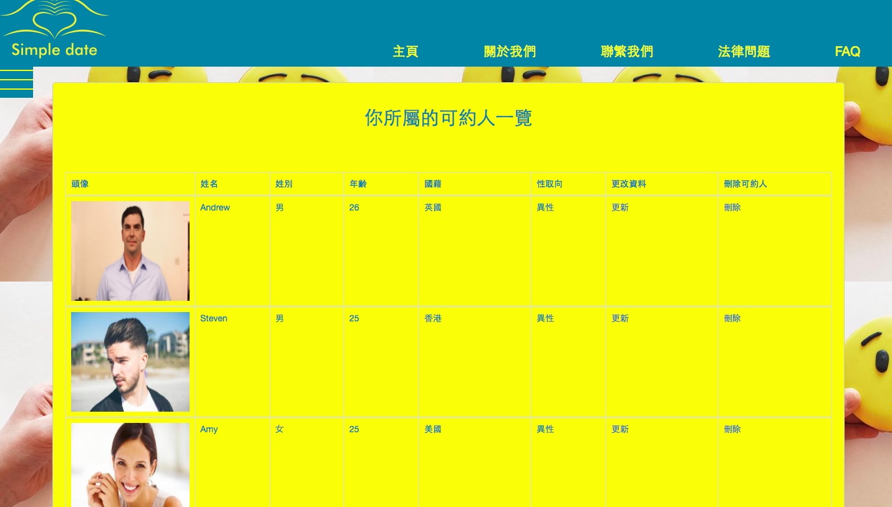
你所屬的可約人
The users can view the profiles they have created on clientList.php. Other than that, the users can also update or remove their details.

Slide 6
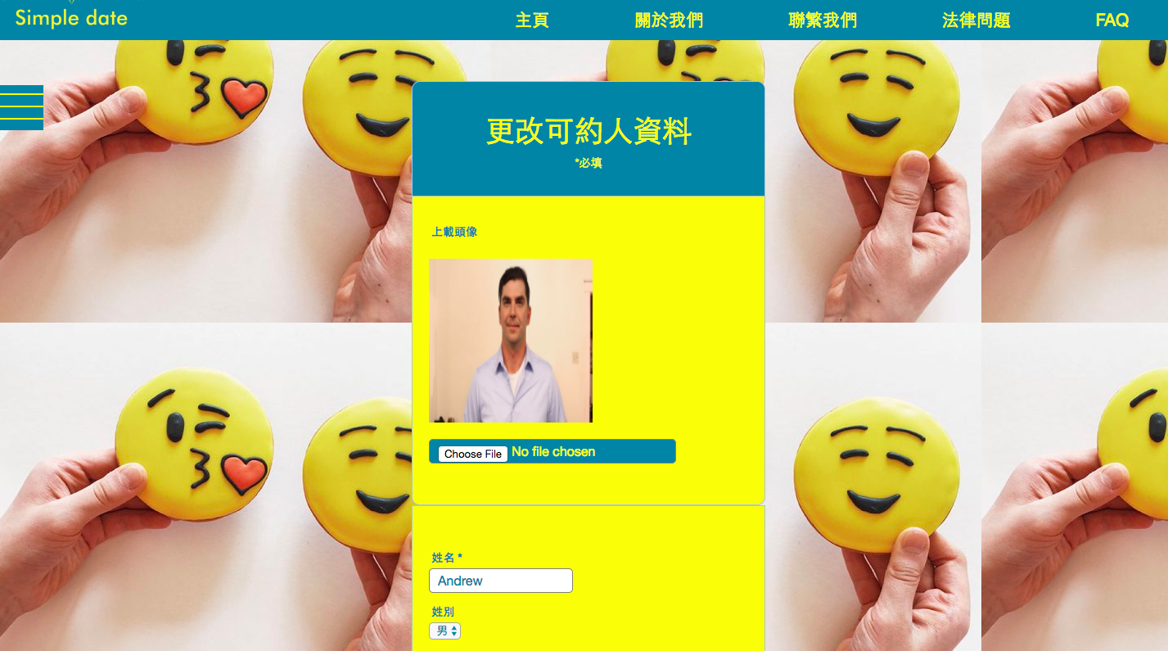
更改可約人資料
The users can edit the details of a profile by clicking ‘更新’ from a row of a specific profiles.

Slide 7
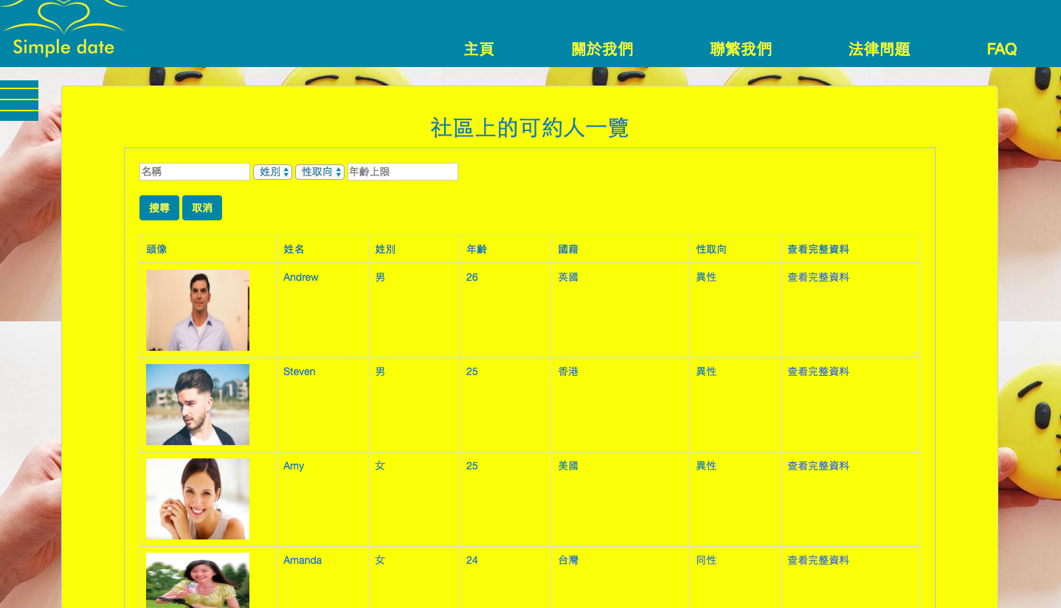
搜尋可約人
Below is the list of instances that has added into the mysql database by using JSTL.
Udate the corresponding row’s record.
SearchClient.php allows users to search all the profiles. The filter function enables
users to search for someone with specific age and sex orientation. ‘查看完整資料’
allows users to view the full profile of others.

Slide 8
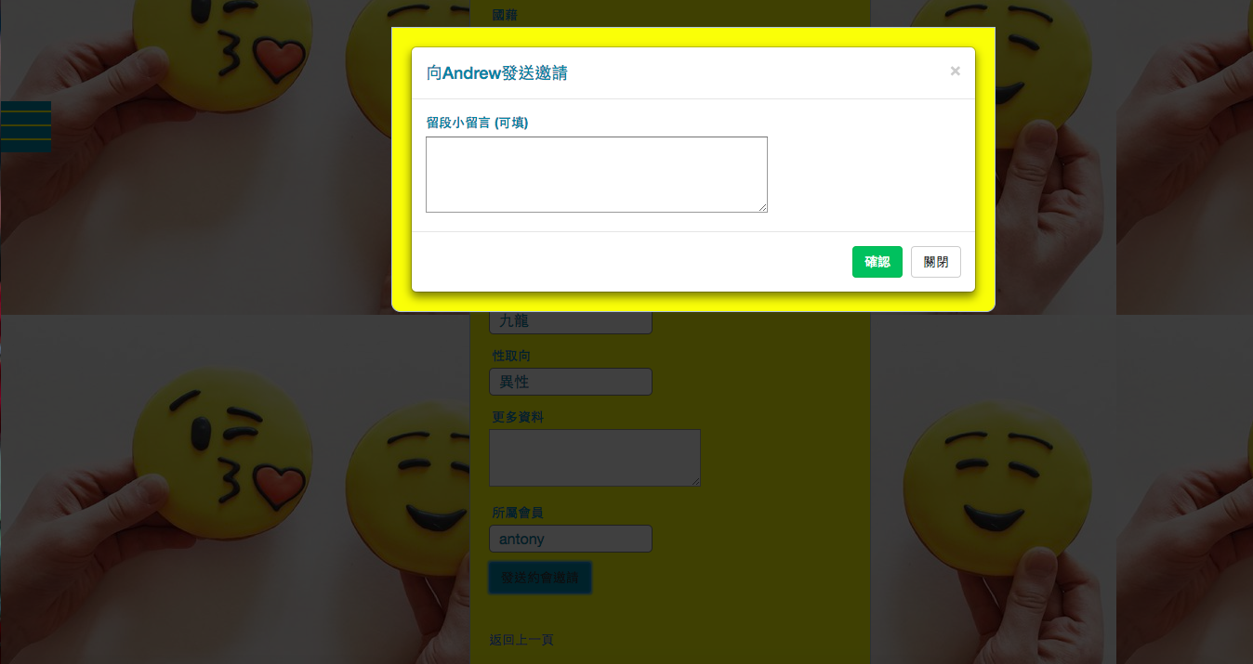
發送約會邀請
Below is the the interface for update an instance.
After viewing the full profile, interested party can send date invites to another by clicking ‘發送約會邀請’. They can also leave a short message to introduce themselves. To confirm the invitation, press ‘確認’.

Slide 9
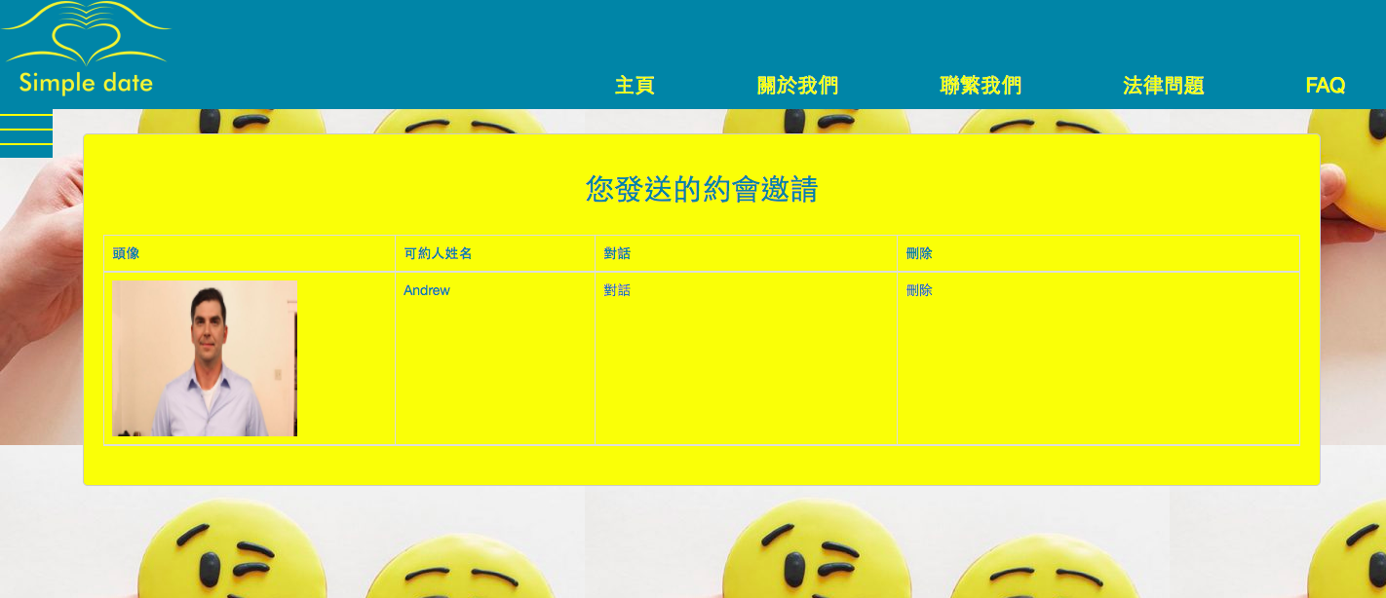
你發送過的邀請
This page usersMessageList.php shows the list of invitations that the users have sent. The user can start the chat by clicking ‘對話’.

Slide 10
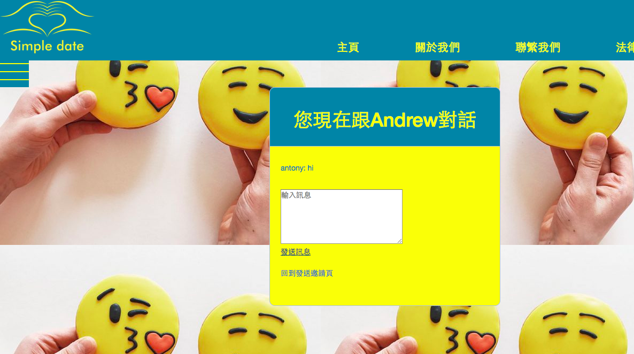
對話
The user can then start a real-time chat.

Slide 11
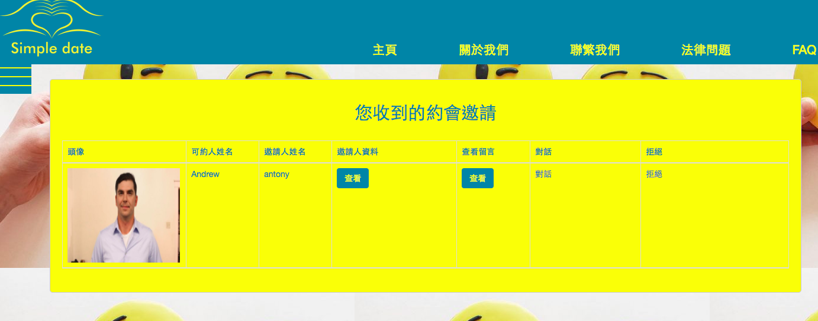
你收到的邀請
Notifications will be sent to the users when they received date invitations from
other users. They can view the list of invitations on notificationReceiverList.php.

Slide 12
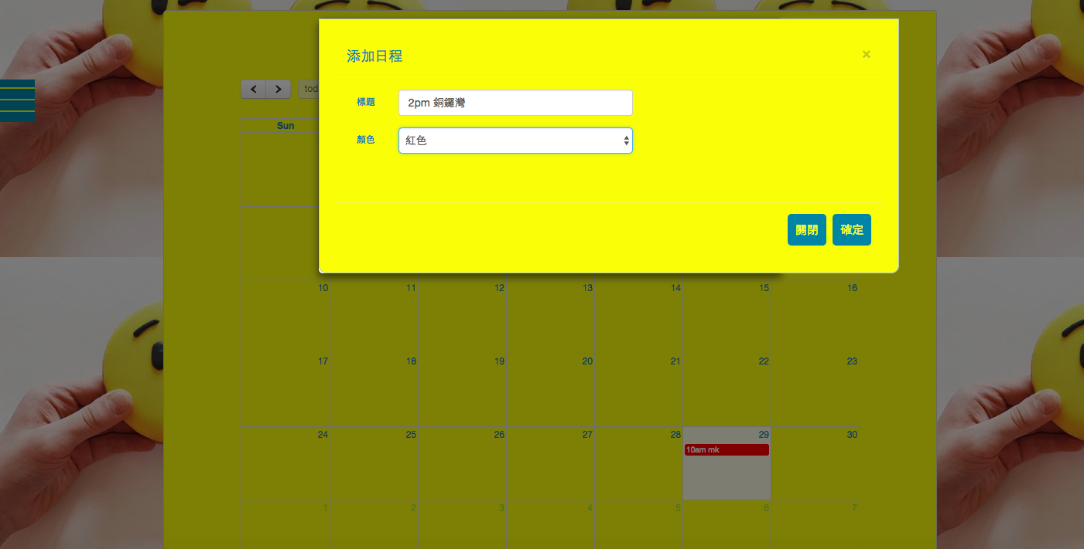
你的日程
User can go to their personalized timetable (calendar.php) to add the events by clicking a specific day. They can also edit/delete the events.

